Slide 1

LightSpeed
IoT Street Lights of the Future

Slide 2
How can we improve the existing system?
Improve Safety
Improve monitoring of the network
Prioritize movement of special users
Improve street use

Slide 3


Slide 6


Light
Connected Network

Slide 7
Smart Street Light:
Actions of smart street lights are influenced by the devices within its network.
Actions of the light are determined by the type of user, the number of users, and the user’s proximity to the light/network node.

Slide 8


Smart Light Usage:
Flashing Light
Light Duration
Light Intensity

Slide 9

Improve Road Safety
Flashing street lights can be used to bring attention to more vulnerable road users and emergency vehicles.

Slide 10

Improve Road Safety

Slide 11
Improve Road Safety

Slide 12
Improve Road Safety

Slide 13
Improve Road Safety

Slide 14

Prioritize Road Users
Transit and emergency vehicles get longer green lights to clear the intersection

Slide 15
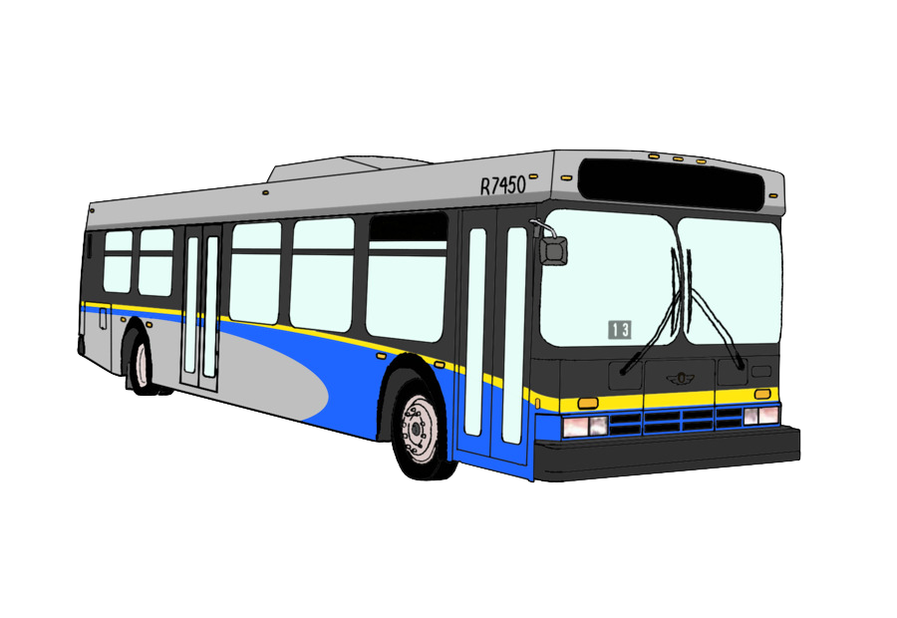
Prioritize Road Users

Slide 16
Prioritize Road Users

Slide 17
Prioritize Road Users

Slide 18

Improve Traffic Monitoring
User 1: Node 1: 5m
Number of users passing through a network
User duration within a network
Direction and speed of users
User 2: Node 1: 4m Node 2: 4m
User 3: Node 2: 5m

Slide 19
Improve Traffic Monitoring
User 1: Node 1: 5m
Stats:
Current Users: 3
User 1:
Distance from Node 1
User 2:
Location: X, Y
User 3:
Distance from Node 2
User 2: Node 1: 4m Node 2: 4m
User 3: Node 2: 5m

Slide 20
Improve Traffic Monitoring
User 1: Node 1: 2m
Stats:
Current Users: 2
User 1:
Distance from Node 1
Moved 3m closer to Node 1
Speed 3m/reading interval
User 2:
Moving South
Moved 1m closer to Node 2
User 2: Node 2: 3m
User 3:

Slide 21
Increased light intensity on-demand
800 Watts
650 Watts
600 Watts
400 Watts
Dynamic street lighting to reduce energy costs

Slide 22
Increased light intensity on-demand
400 Watts
500 Watts
700 Watts
700 Watts
… and improve pedestrian visibility at night

Slide 23
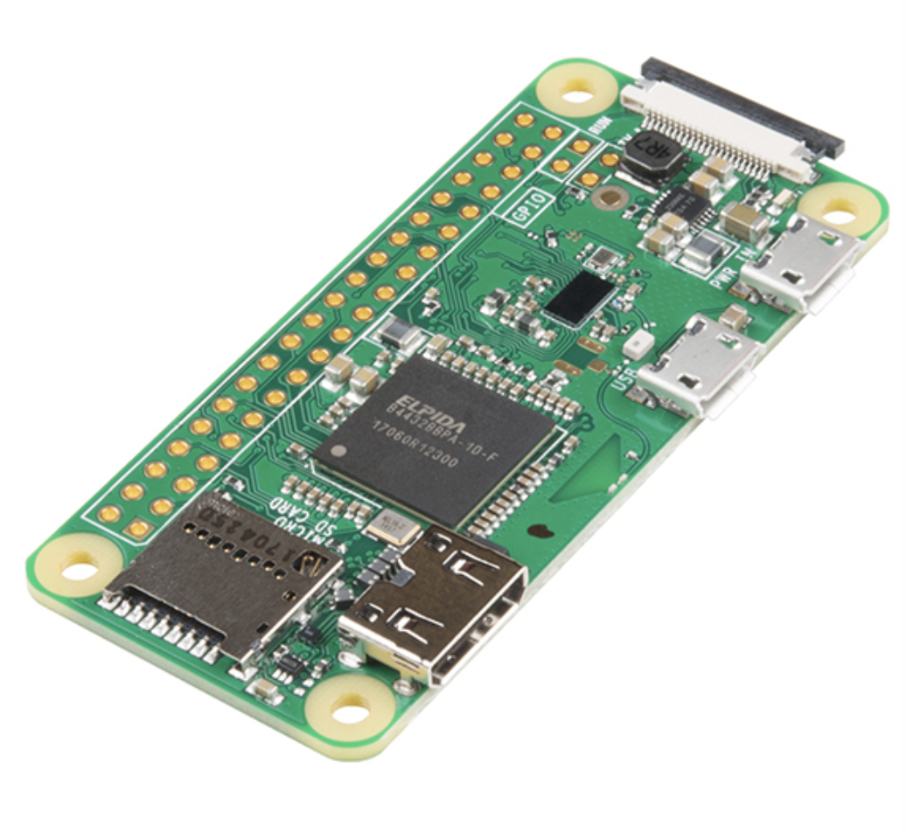
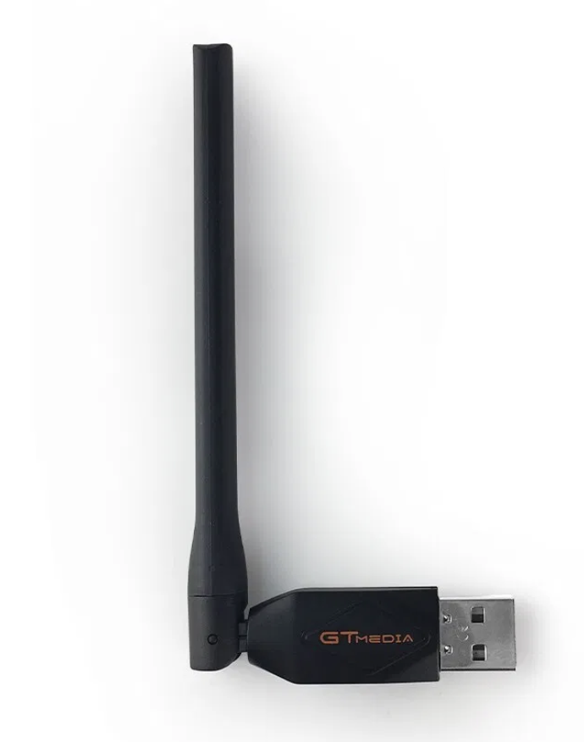
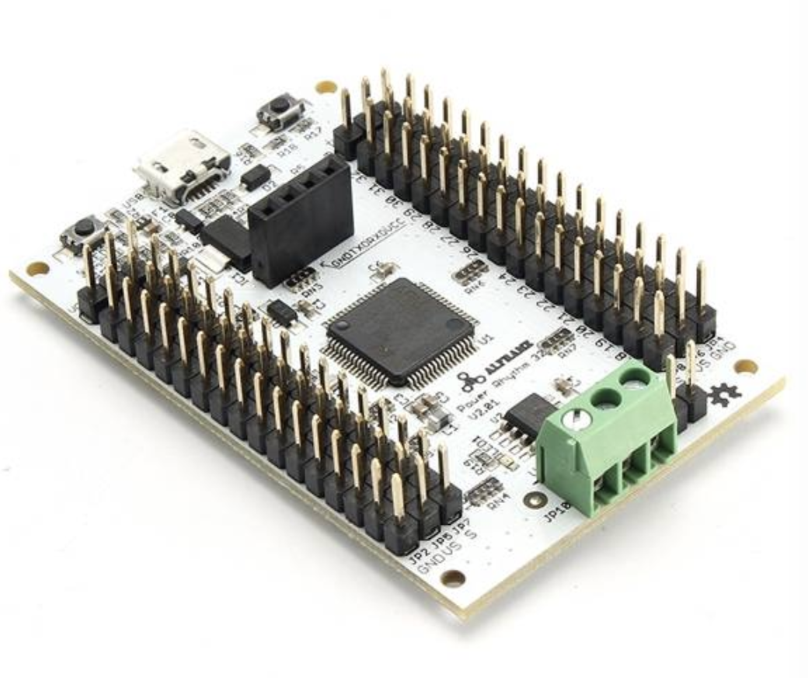
Costs and set-up
Necessary hardware to make a smart light pole:
Mini computer (e.g. Raspberry Pi Zero) ~$5
External Wi-Fi Antenna ~$10
Microcontroller for brightness adjustment ~$2
Hardware cost ~$17

Slide 24
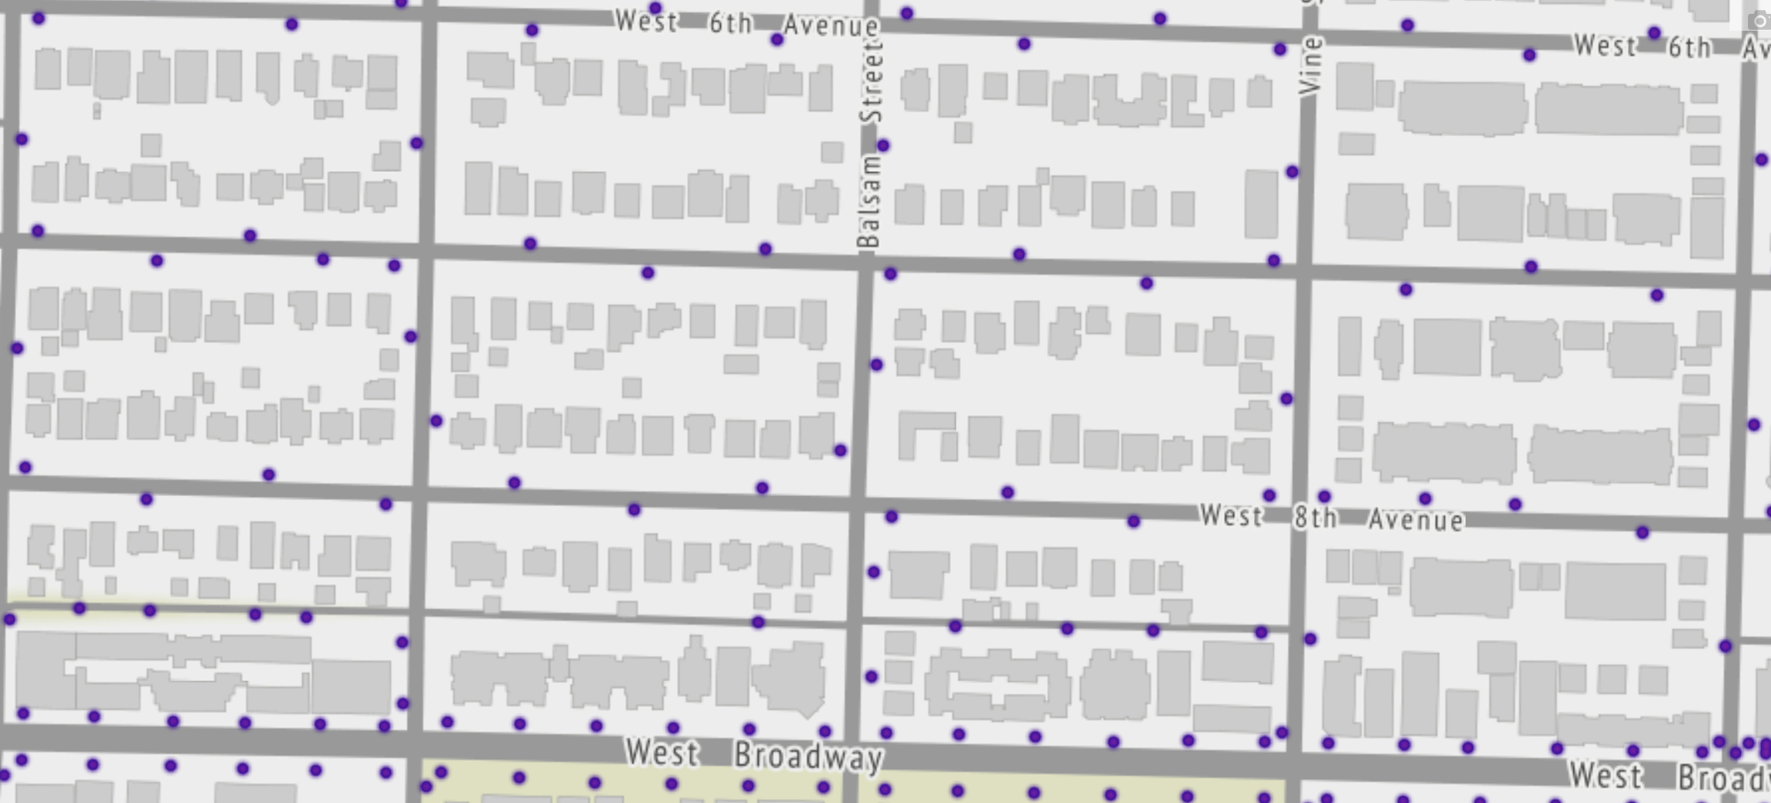
Coverage
A smart light pole ( ) located every 45m would provide full coverage and would allow a position triangulation

Slide 25
Data transmission to centralized data centres
Dummy node - only performs data collection
Master node - sends data to servers via cellular network

Slide 26
Privacy
Only MAC addresses that are randomly generated by the mobile device are collected - they don’t store any information that can identify the user
Encrypted communication between dummy nodes to ensure that no data leaves smart light mesh network
Encrypted communication via cellular network

Slide 27
DEMO

Slide 28
https://www.youtube.com/watch?v=C8kChfpoTfQ&feature=youtu.be

Slide 29
The End

